Slide 1


DATA MINNING &WAREHOUSING
presented by:
NRIJALA DANGOL

Slide 2
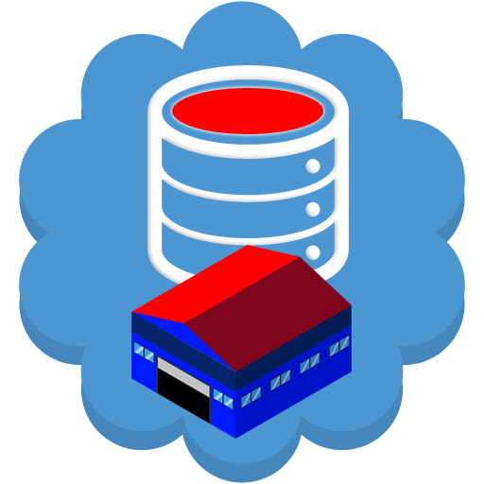
BASIC INTRODUCTION TO DATA MINNING AND WAREHOUSING
A data warehousing create a centralized and organized database for efficient querying and reporting, and data mining digs deep into these data sets to uncover hidden patterns and valuable insights

Slide 3

IMPORTANCES OF THESE IN MODERN DAY
Historical analysis: Enables trend analysis and timely information to support tracking over time.
Customer insights: identifies pattern in customer behavior to improve marketing strategies.
¢Predictive analysis: Forecasts future trends such as sales or market changes.
Data interpretation: consolidates data from multiple sources for unified view of business operation.

Slide 4

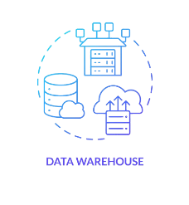
DATA WAREHOUSING
Data warehousing is the process of compiling information into a data warehouse. A data warehouse is designed to support the management decision making process by providing a platform for data cleaning, data integration and data consolidation

Slide 5

BENIFITS OF DATA WAREHOUSING
¢Data Understanding: A data warehouse simplifies corporate data for easier understanding.
¢Continuous Updates: It allows for frequent updates, helping businesses stay current.
¢Accessibility: It makes data more accessible to businesses and organizations.
¢Historical Analysis: It stores large volumes of historical data for trend analysis and future predictions.

Slide 6
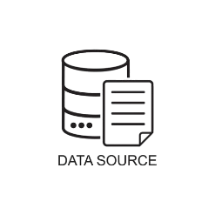


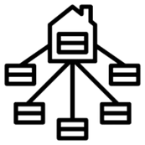
COMPONENTS OF DATA WAREHOUSING ARE:
DATA SOURCE:These are the original systems or applications where data is created or stored
. ELT Process (Extract, Load, Transform):
Extract: Data is pulled from source systems with minimal processing and stored in a staging area
Load: Raw data is loaded into the data warehouse, either incrementally or in bulk.
Transform: Data is cleaned, formatted, aggregated, and validated within the data warehouse.
DATA WAREHOUSE: The core of the data warehouse is where transformed data is stored for long-term analysis. This storage structure includes:
. Data Marts: Data marts are subsets of the data warehouse, typically focused onspecific business areas.

Slide 7
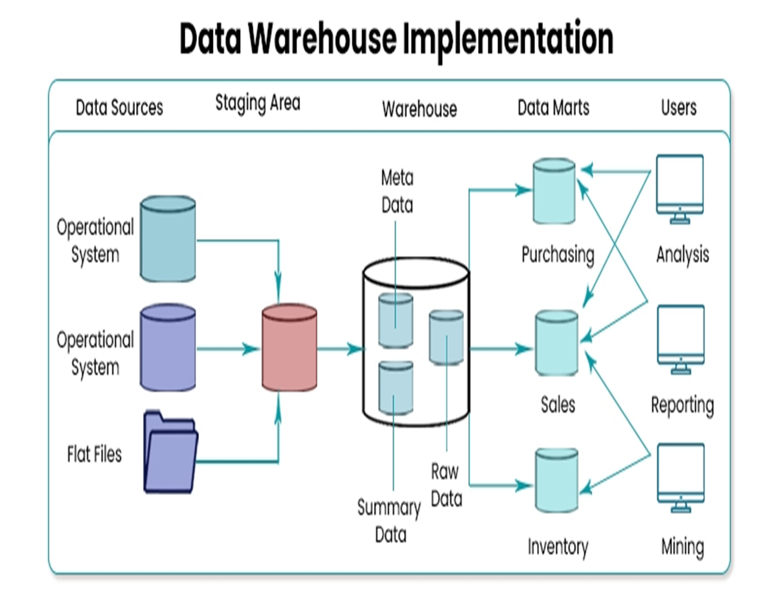

Slide 8

DATA MINNING
It is the process of finding patterns and correlations within large data sets to identify relationships between data.
¢-Data Cleaning- removes error ,inconsistencies, and redundant informationto ensure high quality data for mining
¢-Pattern discovery-identifies meaningful patterns trends or relationships.
¢-Data visualization-Presents mined data results in graphical format for easier interpretation.

Slide 9
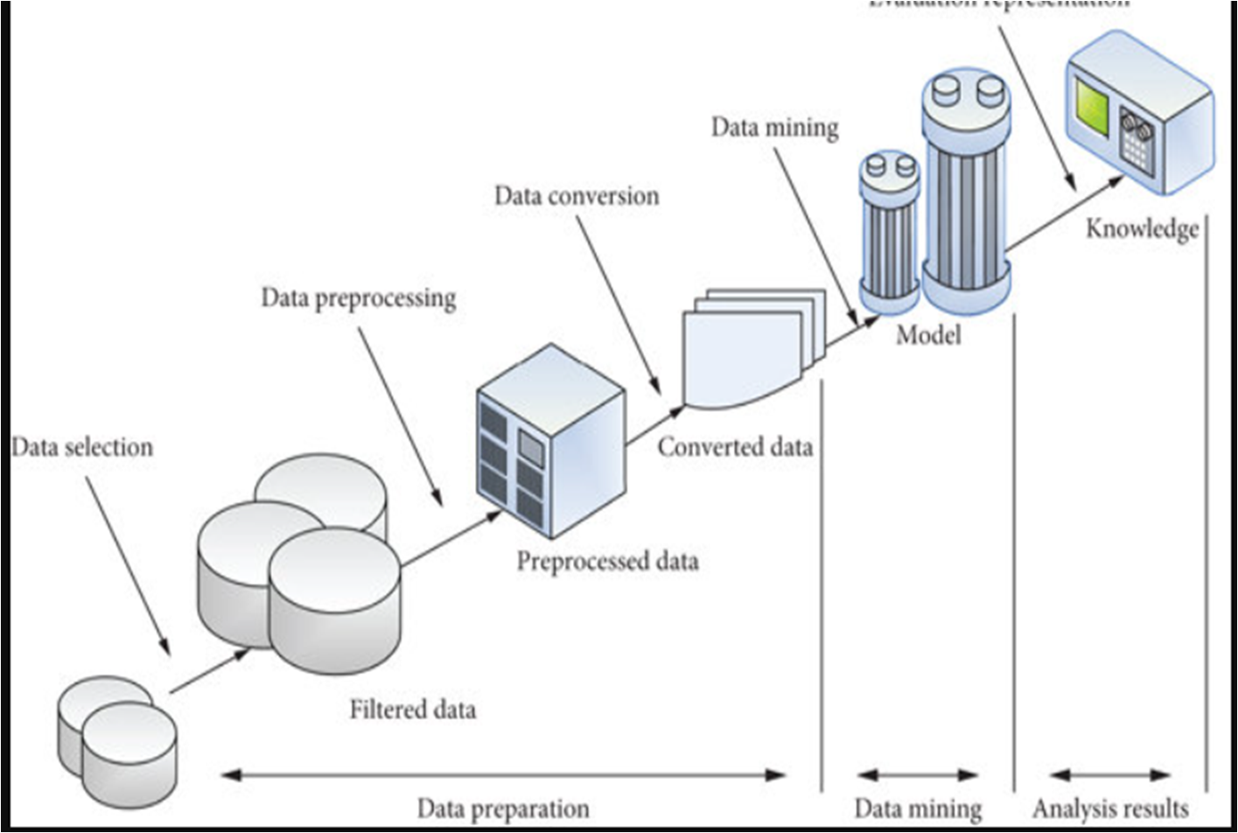
PROCESS FOR DATA MINING

Slide 10
PROCESS OF DATA MINNIG
Data Collection: Gather data from various sources.
Data Preprocessing: Clean and prepare data by handling missing values and transformations
Data Exploration: Use visualizations and statistics to find patterns.
Model Building: Apply mining techniques to uncover insights or make predictions
Evaluation: Assess model accuracy and relevance.
Interpretation & Presentation: Present results to stakeholders with reports and visuals.
Deployment: Implement the model into real-world applications
Monitoring & Maintenance: Regularly update the model to maintain accuracy.

Slide 11
RELATION BETWEEN DATA MINING AND WAREHOUSING
Data warehousing provides a foundation for data mining, by providing a structured, integrated repository of information. Data mining, in turn, leverages this warehouse to uncover hidden patterns, trends, and insights that drive strategic decision-making. A data warehouse acts as the foundation for data mining by providing a centralized, organized repository of data from various sources, which allows data mining algorithms to efficiently analyze large volumes of structured and integrated information to discover hidden patterns, trends, and insights, ultimately supporting informed decision-making

Slide 12

APPLICATION
E-Commerce: it is used in e commerce for personalized recommendation
Banking :its used to detect fraud
Retail:walmart uses data warehousing and mining to analyze sales pattern and optimize supply chain
Health care: used to analyze patients data to prevent diseases outbreaks and optimize treatments.

Slide 13

TOOLS USED IN DATA WAREHOUSING AND DATA MINNING
1. Amazon Redshift: cloud-based warehouse service for fast querying and analytics
2. Google Bigquery:serverless data warehousing solution designed for large scale data analysis
For data mining
1.RAPIDMINER: powerful tool for data preparation, machine learning, and model deployment.
2.PYTHON LIBRARIES: flexible programming solution for data analysis and predictive modeling

Slide 14
THANK YOU

